Slide 1
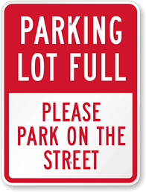
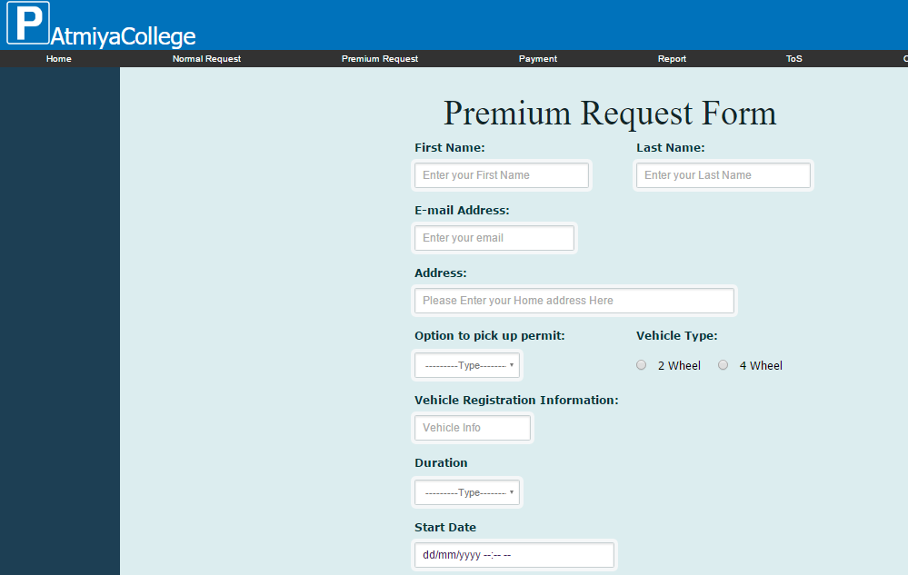


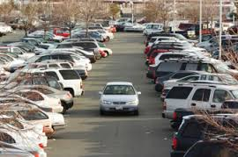


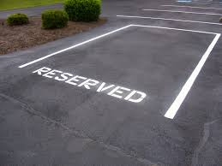

He sent out his request for a parking lot
A visitor of Atmiya College worried about how to park his car at the college
Then he found out there is a website to request for a parking lot
There is a parking lot reserved for him
Now he don’t have to worry about where to park his car
He receive an conformation email after he get approved for his car park request

